Slide 1
The Design of an AC-dc power supply for welding machines
Senior Design Project
By Iragena Bangamwabo
Student -Electrical Engineering

Slide 2
Outline
Introduction
Objective
Project Description
Design Requirements
Design Constraints
Design Approach
Tasks
Timeline
Implementation of Tasks

Slide 3
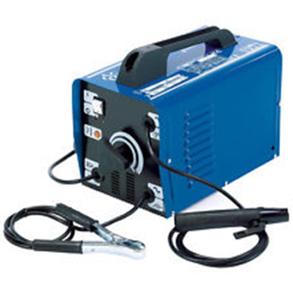

Introduction
A welding power supply is a device that provides electric current to perform a fusion of materials(usually metals or thermoplastics) by melting them, which requires a high current and high voltage.
Notes:
The focuses this project is to design a circuit that will serve as a power supply to in a welding machine.

Slide 4
Objective
The objective of this project is to design a power supply that will take a wide range of AC input voltage and convert it into a steady DC output voltage and high current output.
Notes:
The objective of this project is to develop a power supply that will take a wide range of AC input voltage and convert it into a steady DC output voltage.

Slide 5
Design Requirements
AC input voltage range: 120V – 600V
Single/three phase
DC output voltage: 285V
Output current: 50A
A circuit protection mechanism

Slide 6
Constraints
Budget – Estimated $1000 based on:
Materials
Supplies
Equipment
Limited Resources
High voltage power source
Software for design and simulation purposes

Slide 7
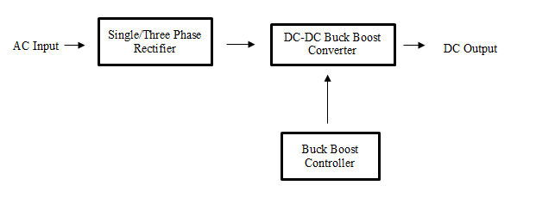
Design Approach

Slide 8
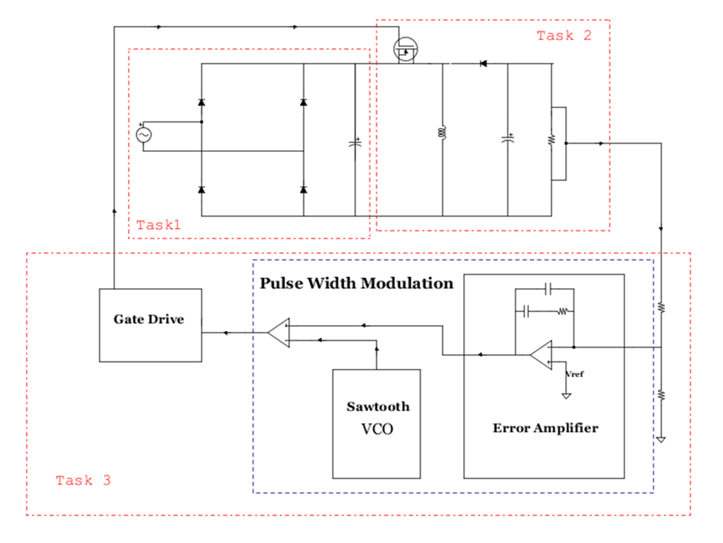
Implementation Plan
Tasks
System Diagram
Task 1. Design the AC-DC Rectifier
Task 2. Design a DC-DC converter
Subtask 1. Buck-Boost Converter Analysis
Subtask 2. Transfer function
Task 3. Design a control unit for the power supply
Subtask 1. Design the compensator
Subtask 2. Design a Voltage control Oscillator
Subtask 3. design a Gate drive
Task 4. Design Verification
Subtask 1. Testing of the whole system
Subtask 2. System refinement
Task 5. Build the circuit
Subtask 1. Design of the PCB
Subtask 2. Perform soldering
Task 6. Testing and Refinement

Slide 9
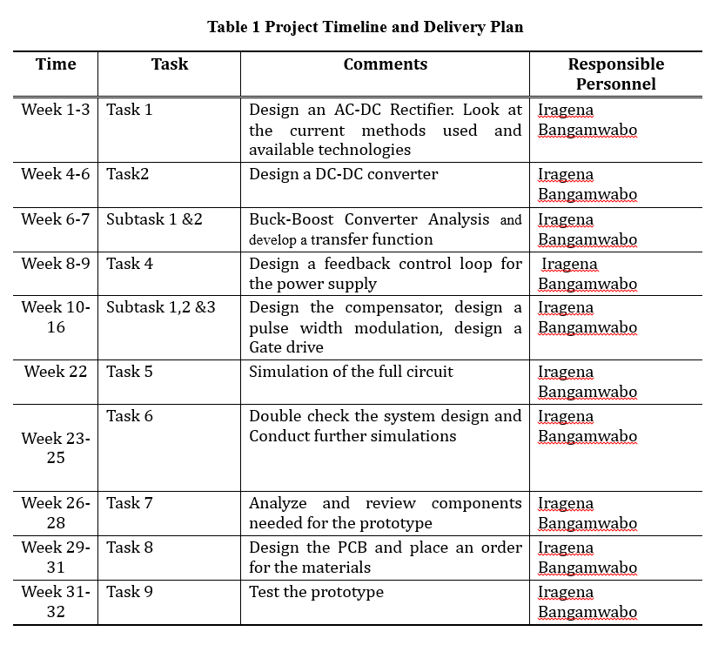
Timeline

Slide 10
Implementation of task 1
Design of an a C-DC rectifier

Slide 11
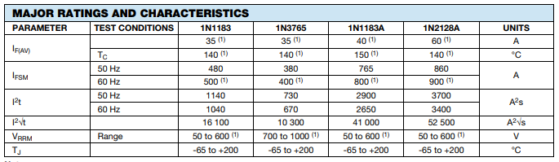
Selected Component
Power Diode: The selected power diodes that meet the parameters for this circuit are VS-1N2128A, manufactured by Vishay Semiconductors

Slide 12
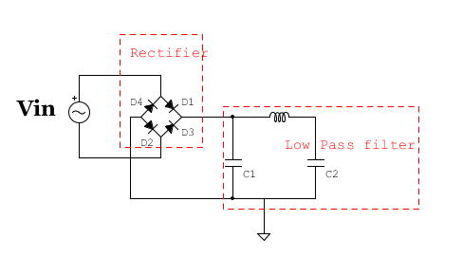
Rectifier System Diagram
When the positive half cycle of the supply D1, D2 diodes conducts in a series while diodes D3 and D4 are reverse biased.
During the negative half cycle, D3 and D4 diodes conduct in a series and diodes D1 and D2 switch off as they are now reverse biased configuration
The low pass filter is used to filter the output waveform due to high ripple effect of the DC output from the rectifier
Notes:
The series inductor presents high impedance at the ripple current frequency.

Slide 13
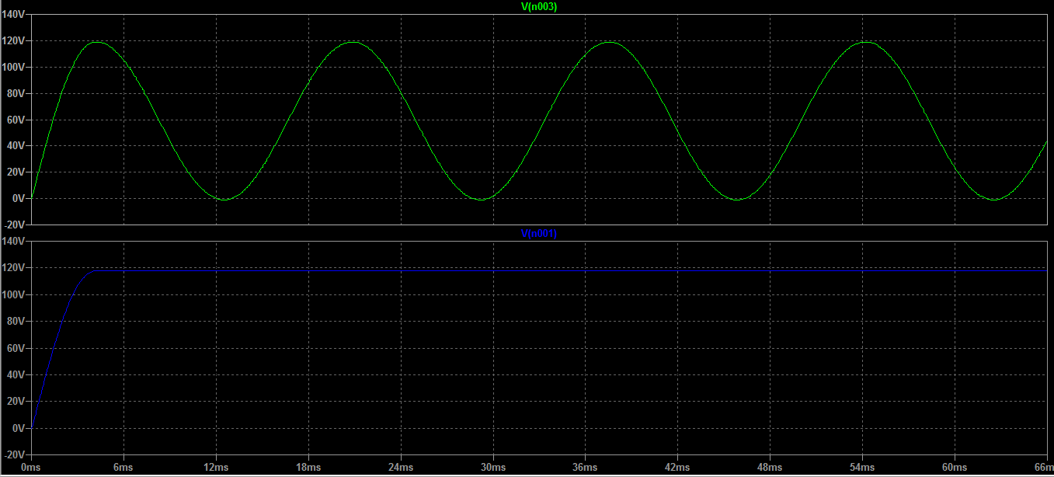
Simulation Results
Input Vs output wave form after low pass filter

Slide 14
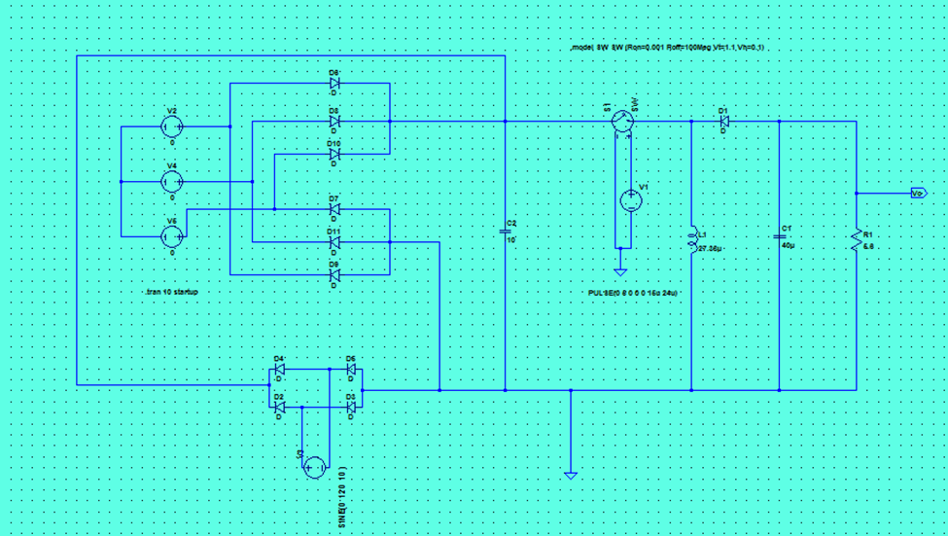
Three Phase Incorporated

Slide 15
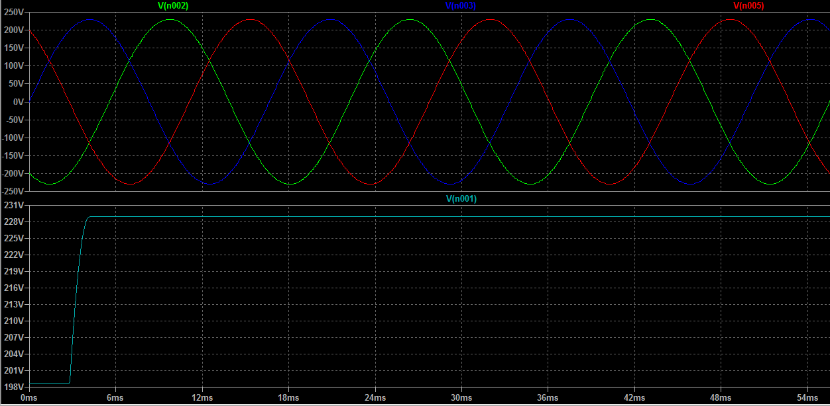
Simulation Results

Slide 16
Implementation of Task 2
Design of DC-DC converter

Slide 17
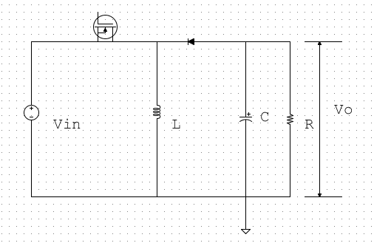
System Requirements
The converter will operate in DC steady state under the following conditions:
V-in = 120V_RMS
V_o = 285V
P_o = 14.4KW
f_S = 200kHz

Slide 18
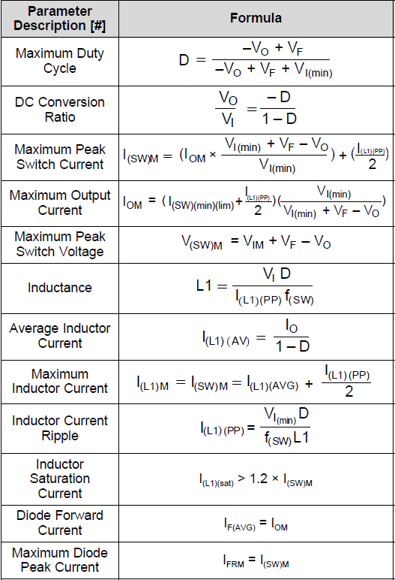

Calculating components values
$I_{in}$ = 84.706A
D = 0.626
L = 26.621μH
$T_{S}$= 5μs
$I_{o}$ = 50.526A
$R_{L}$ = 5.64Ω
C = 40μF

Slide 19
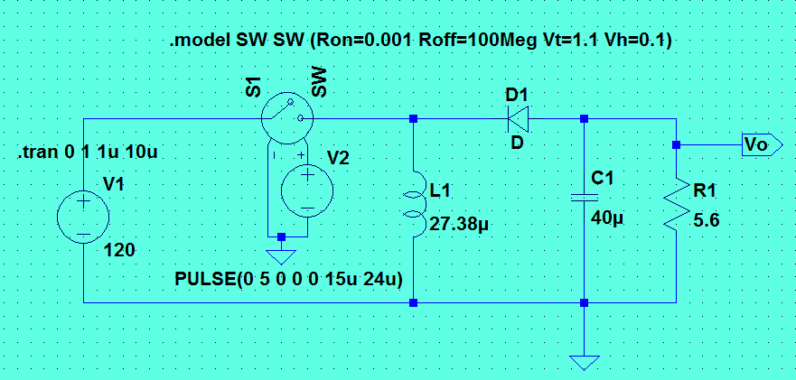
Spice Simulation
The circuit model shown below with calculated components values will be used for a SPICE simulation of the Buck-boost power supply

Slide 20
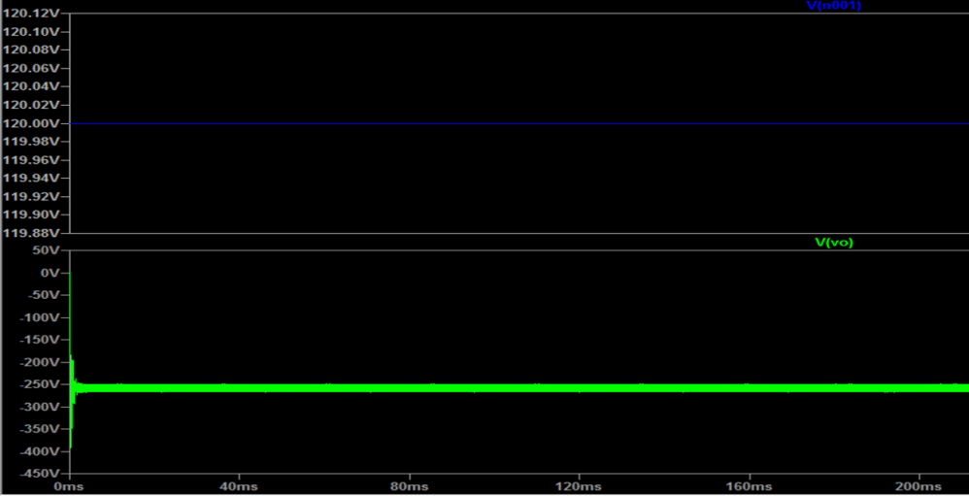
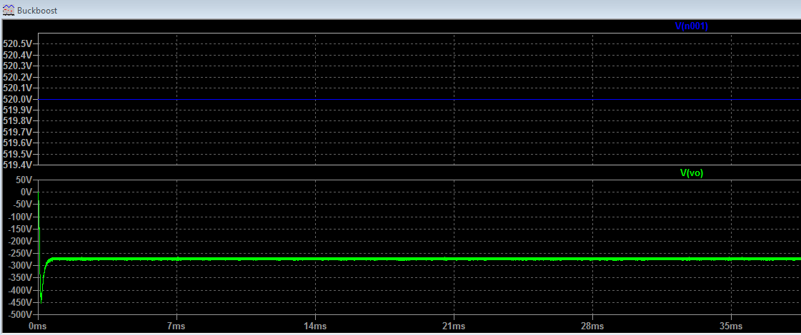
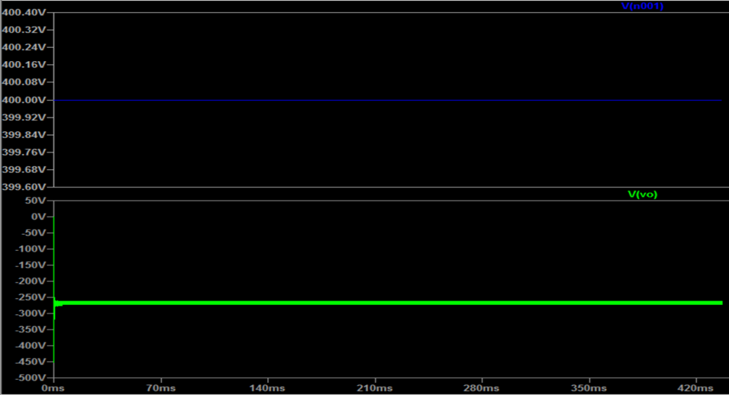
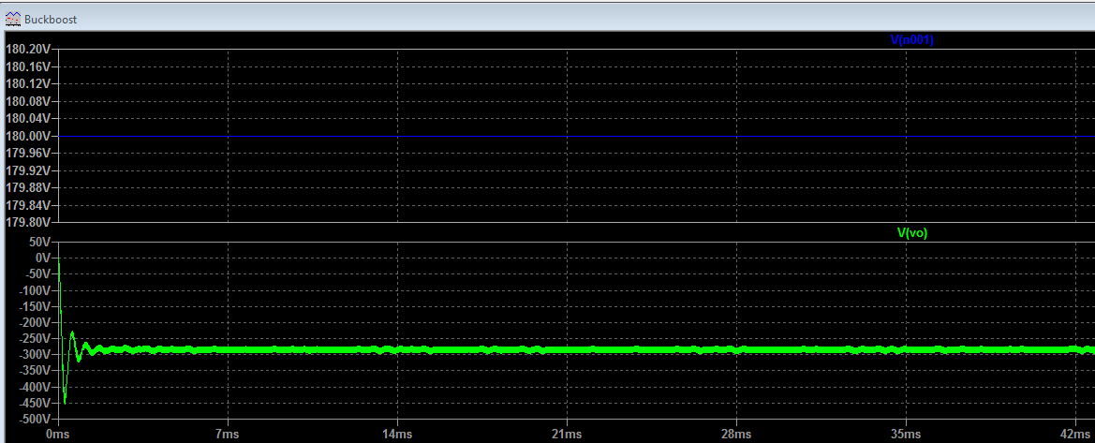
Spice Simulation Input Vs Output
At Vin =120, 180
At Vin =400, 520

Slide 21
Implementation of task 3
Design of the control Unit

Slide 22
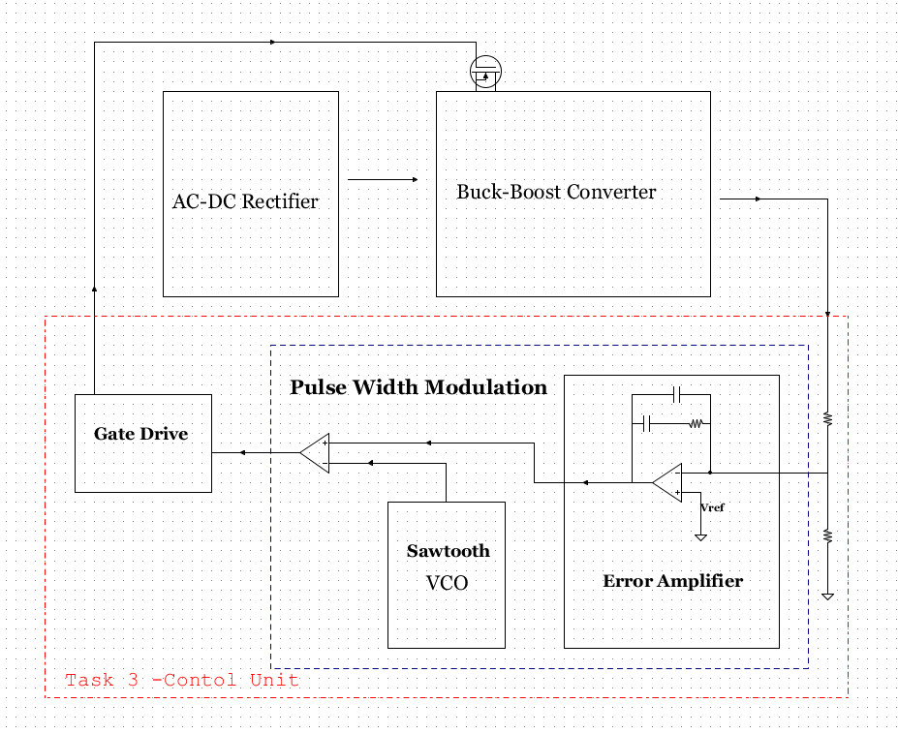
Block Diagram

Slide 23
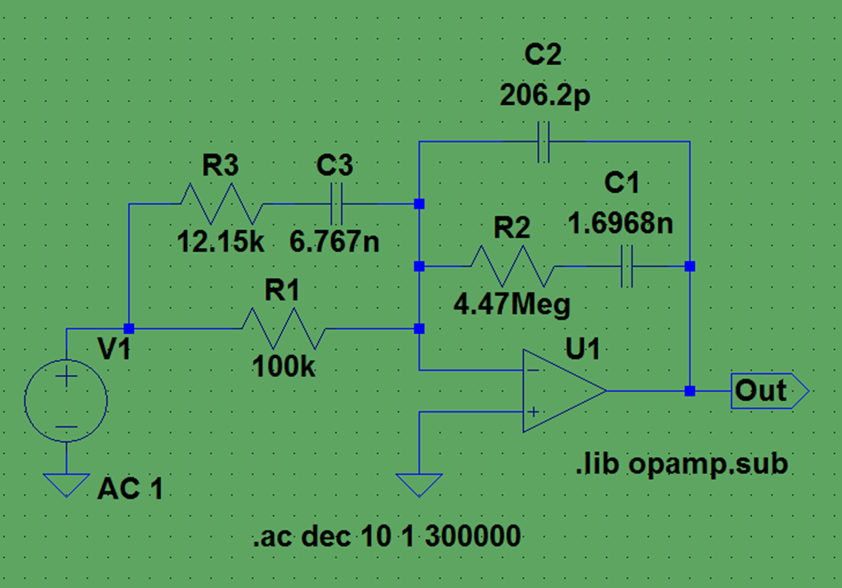
Error Amplifier
The purpose of this error amplifier is to counteract gains and phases contained in the out put of the buck boost converter that could jeopardize the stability of the system

Slide 24
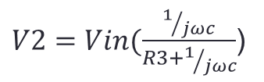
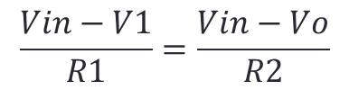

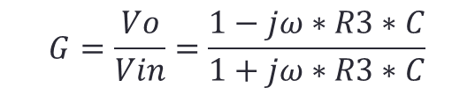
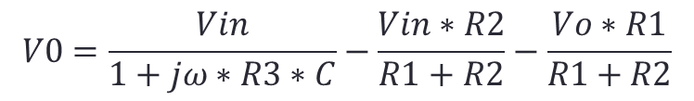
Formulas Used
$$\frac{Vin−V1}{R1}=\frac{Vin−Vo}{R2}$$
$V2=Vin(\frac{1/{jωc}}{R3+1/{jωc}}$)
$$V0=\frac{Vin}{1+jω∗R3∗C}−\frac{Vin∗R2}{R1+R2}−\frac{Vo∗R1}{R1+R2}$$
$$G=\frac{Vo}{Vin}=\frac{1−jω∗R3∗C}{1+jω∗R3∗C}$$
$$θ=−2arctan⁡(w∗C∗R∗3)$$

Slide 25
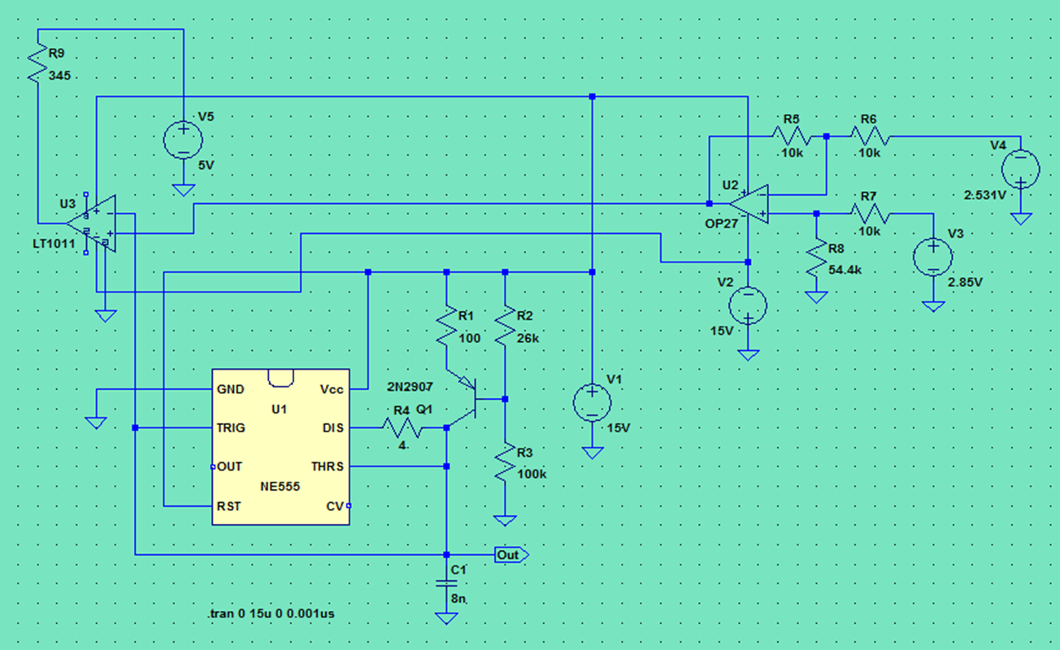
Pulse Width Modulation
To enhance the tracking performance of the PWM voltage controlled buck boost converter, an op amp and a 555timer network is used as a voltage controlled oscillator (VCO)
The 55timer will generate a triangular waveform which is passed to the inverting input of the comparator
By passing the input voltage to the non-inverting comparator input, a PWM waveform is produced.

Slide 26
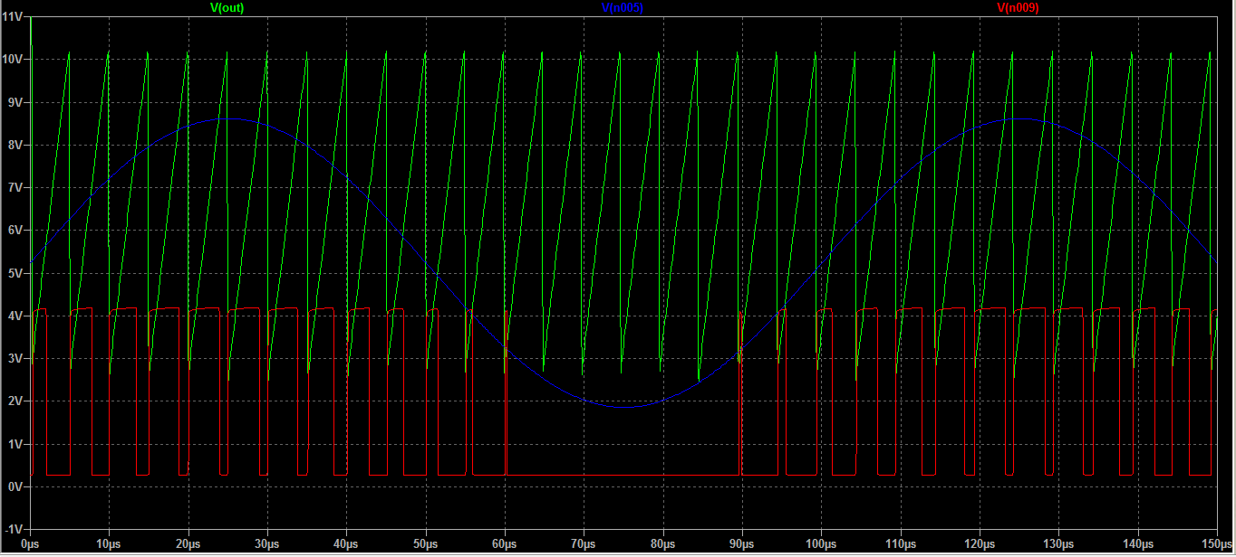
Simulation Results
The saw tooth is the output of the voltage controlled oscillator
The comparator generated pulsating waveform

Slide 27
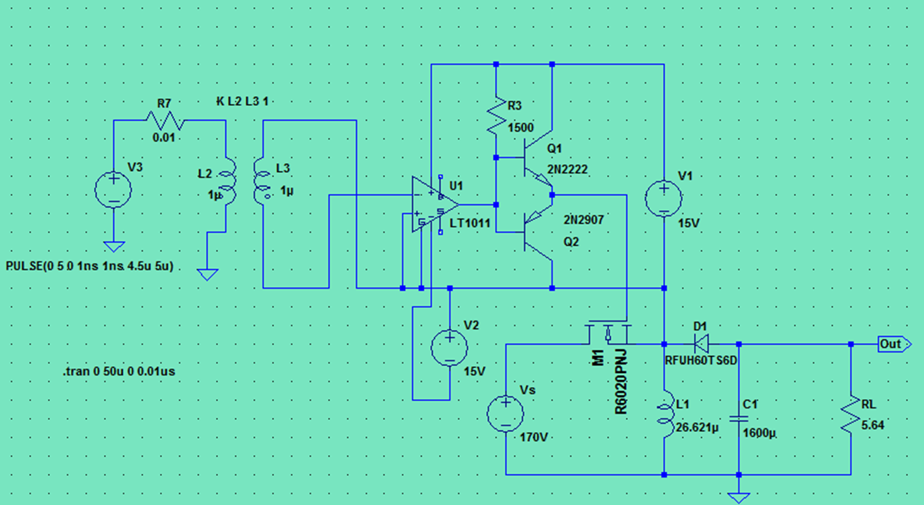
Gate Drive
In order for this system to operate it needs a switch that can handle a significant power levels to be able to work correctly.
For high frequencies, MOSFETs require a gate drive circuit to do the on/off operation at the desired frequency

Slide 28
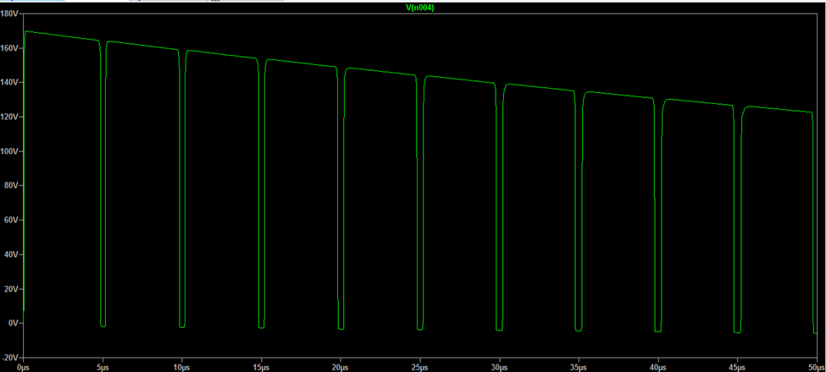
Simulation Results
During the on-time of the switch a small DC current flows keeping the gate in an on and off state.

Slide 29
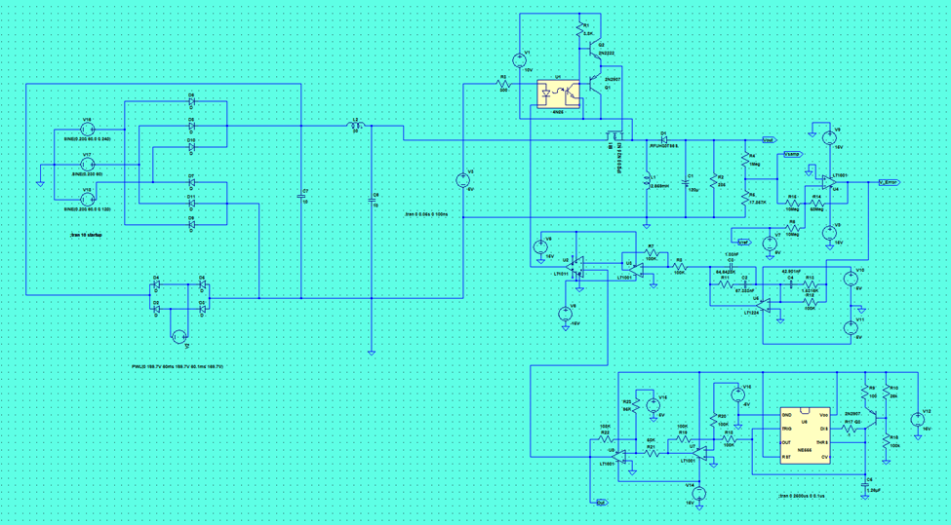
Full Circuit

Slide 30
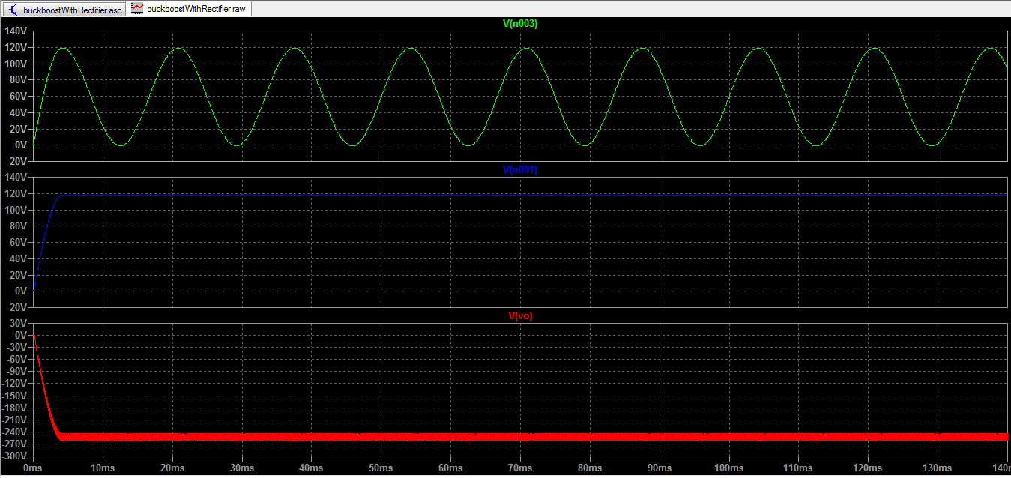
Simulation Results

Slide 31
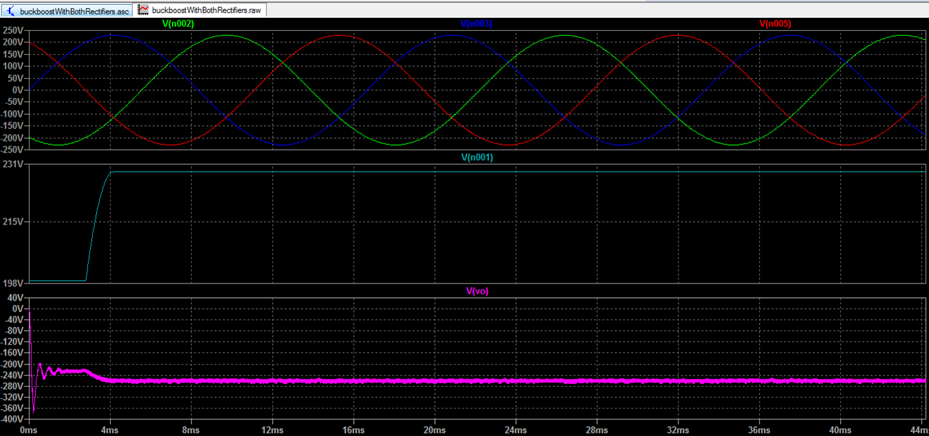
More Simulations

Slide 32
Implementation of task 4
The Design of a pcb

Slide 33
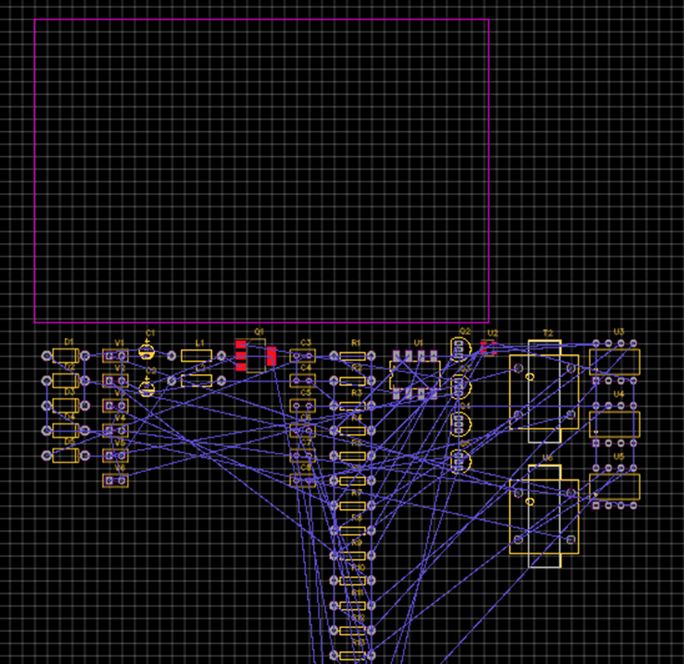
Importing Schematics

Slide 34
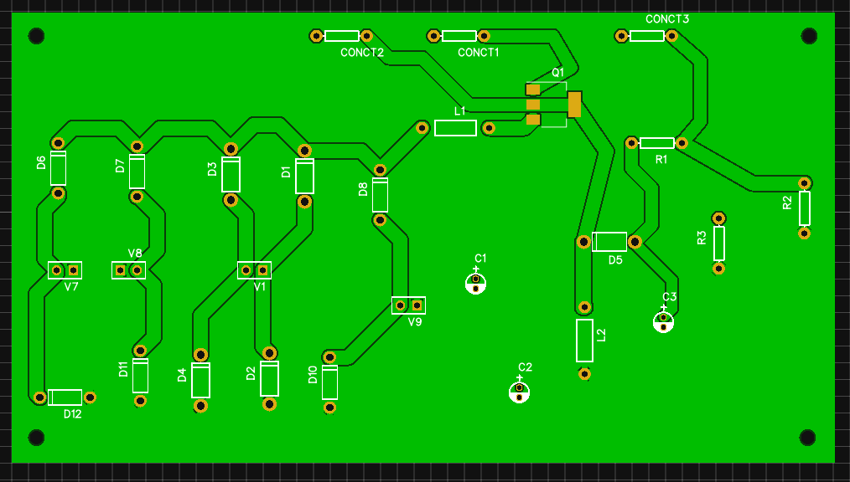
PCB1

Slide 35
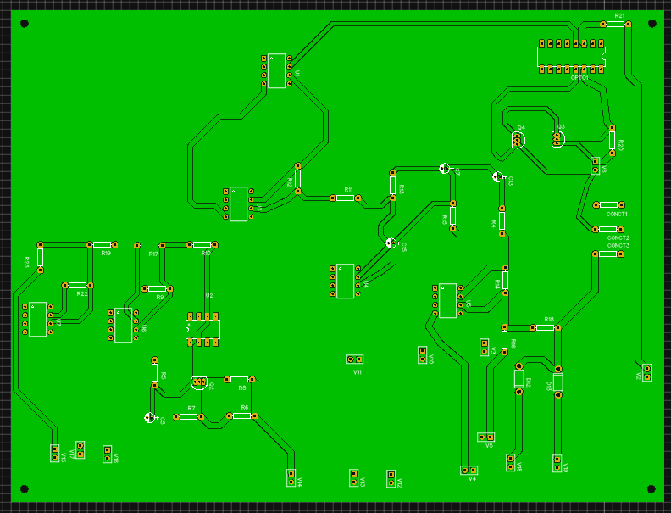
PCB 2

Slide 36
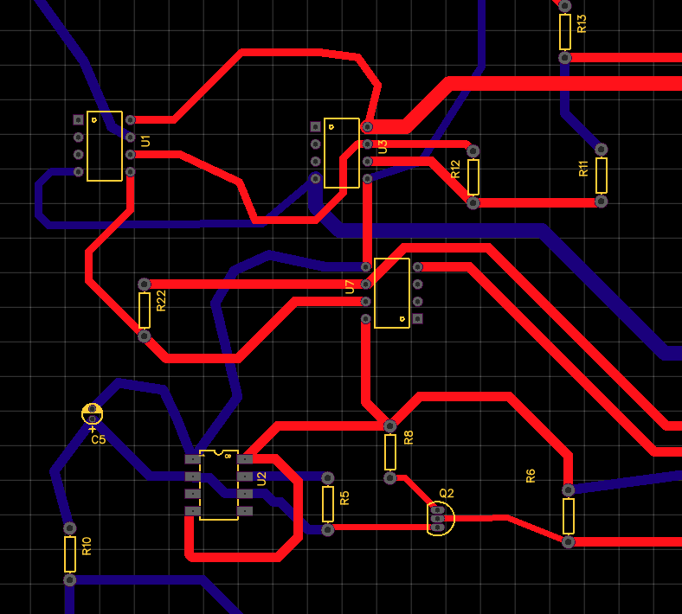
PCB Design

Slide 37
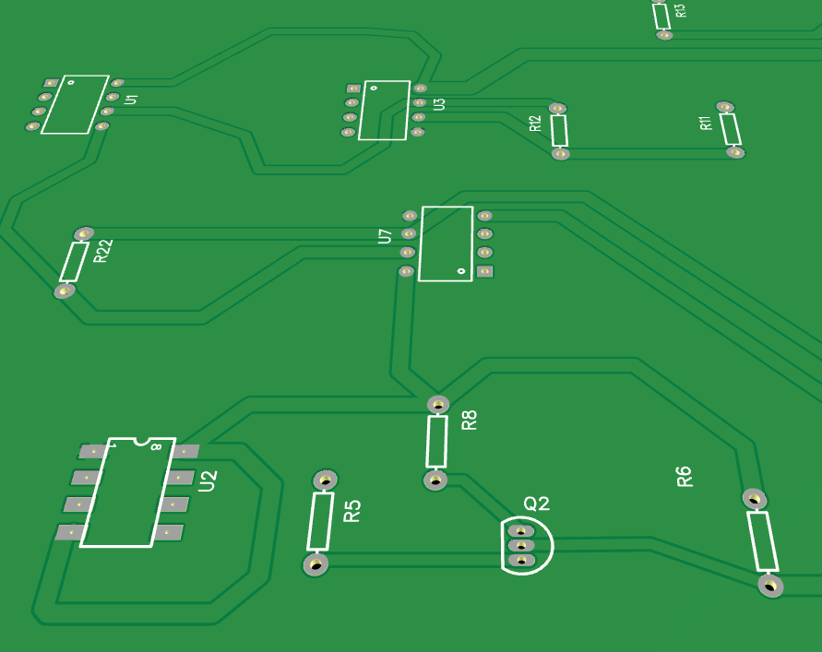
Photo view

Slide 38
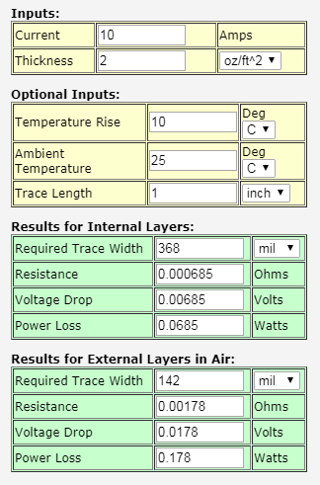
Online trace-width calculator

Slide 39
Acknowledgment
References
A. N. (2011, June 06). Power, Electronic Systems, Applications and Resources on Electrical and Electronic Project-Thesis. Retrieved December 04, 2017
Introduction of Three phase Half/Full Converter. (2017, January O5). Retrieved December 04, 2017
Tai-Ming, T. T. (1988, November). FIRING CIRCUITS FOR THREE-PHASE POWER ELECTRONIC CIRCUITS. Retrieved October, 2017.
CHAIJARURNUDOMRUNG, K, & AREERAK, K. (2011, April). Modeling and Stability Analysis of AC-DC Power System with Controlled Rectifier and Constant Power Loads. Retrieved November 04, 2017, from
Dr. Alvernon Walker Engineering Department
(UMES)

Slide 40
THE End
Questions/ Comments

